Slide 1
Data Import
(eXcelerate)

Slide 2
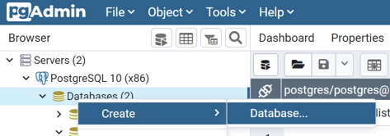
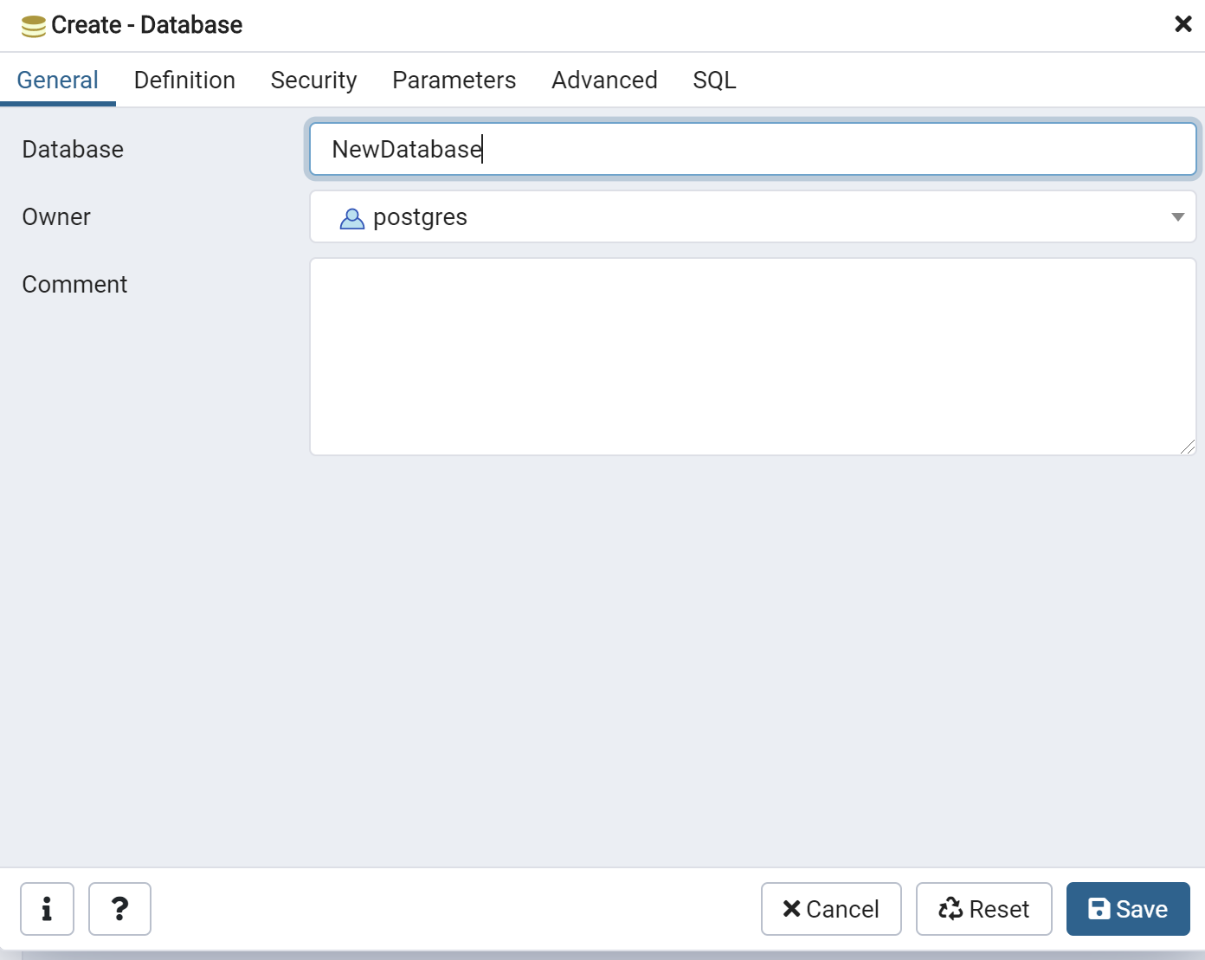
Create Database
````
PostgreSQL
Right click on Databases > Select Create > Name the database > Hit Save
(eXcelerate)

Slide 3
Show Databases
````
To show a list of all databases in SQL, perform the following:
MySQL
SHOW DATABASES;
SQL Server
SELECT name FROM SYS.DATABASES
(eXcelerate)

Slide 4
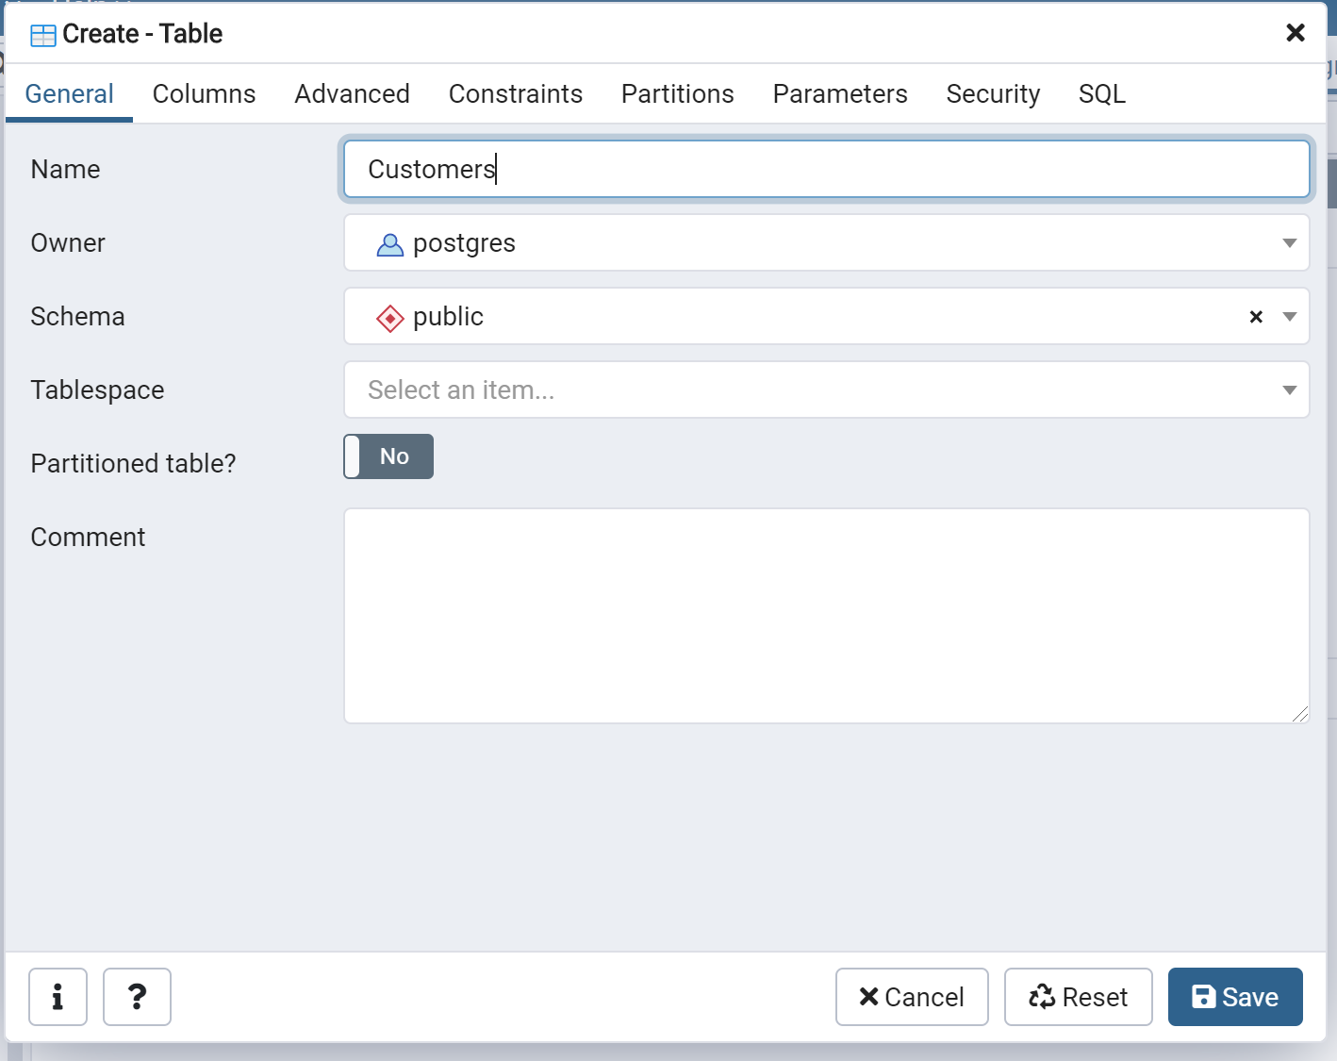
Create Tables
````
PostgresSQL
Click on the database > click on schemas > click on Tables > right click and select Create Table > Name the table > Save
(eXcelerate)

Slide 5
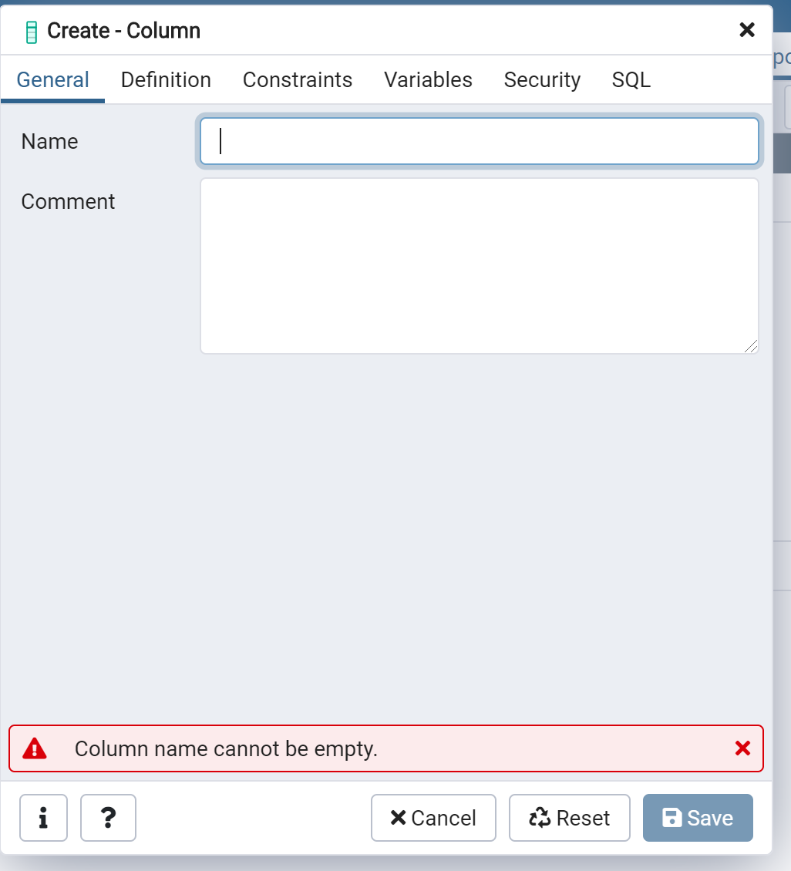
Insert Data into Tables (Columns)
````
Postgres SQL
1.) Right click on columns > Create > Columns
2.) Input column name
(eXcelerate)

Slide 6
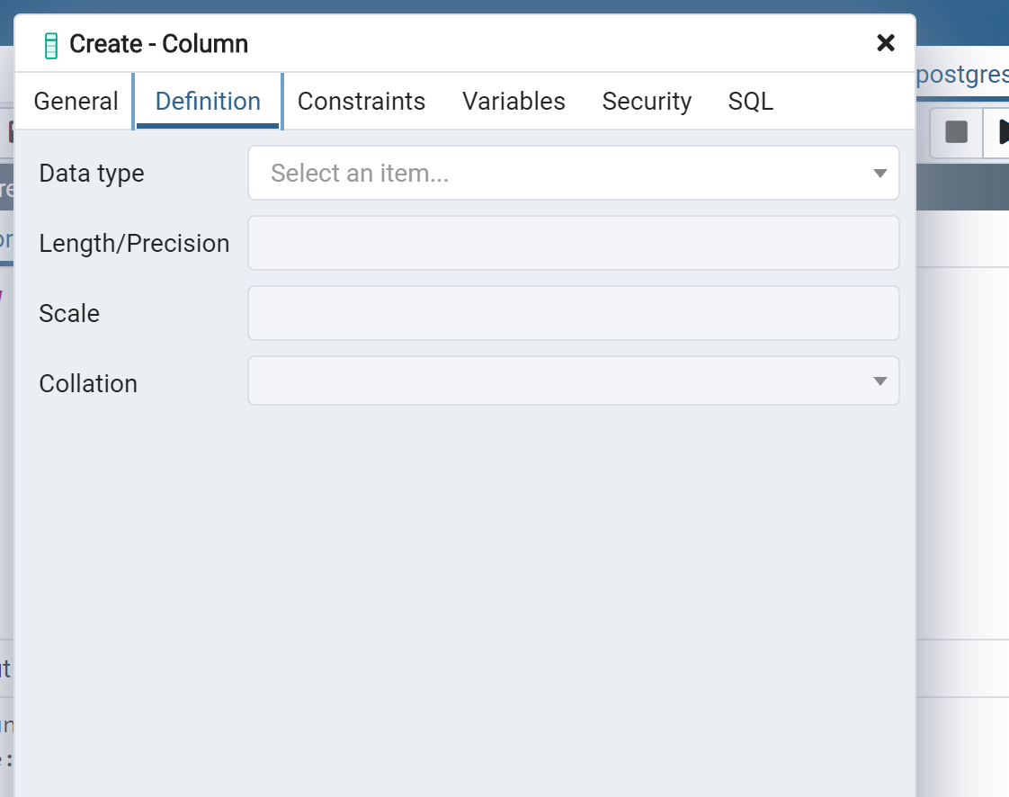
Insert Data into Tables (Columns)
````
Postgres SQL
3.) Click on Definition
4.) Choose Data Type > Hit Save
(eXcelerate)

Slide 7
Insert Data into Tables (Columns)
````
Postgres SQL
5.) Keep repeating steps 1 – 4 until all columns are in the table
(eXcelerate)

Slide 8
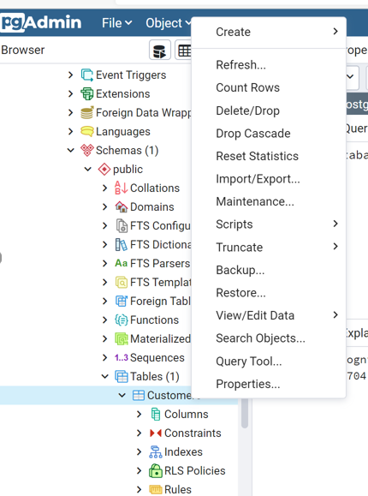
Insert Data into Tables (Records)
````
Postgres SQL
1.) Right click on new table name > Select Import/Export
(eXcelerate)

Slide 9
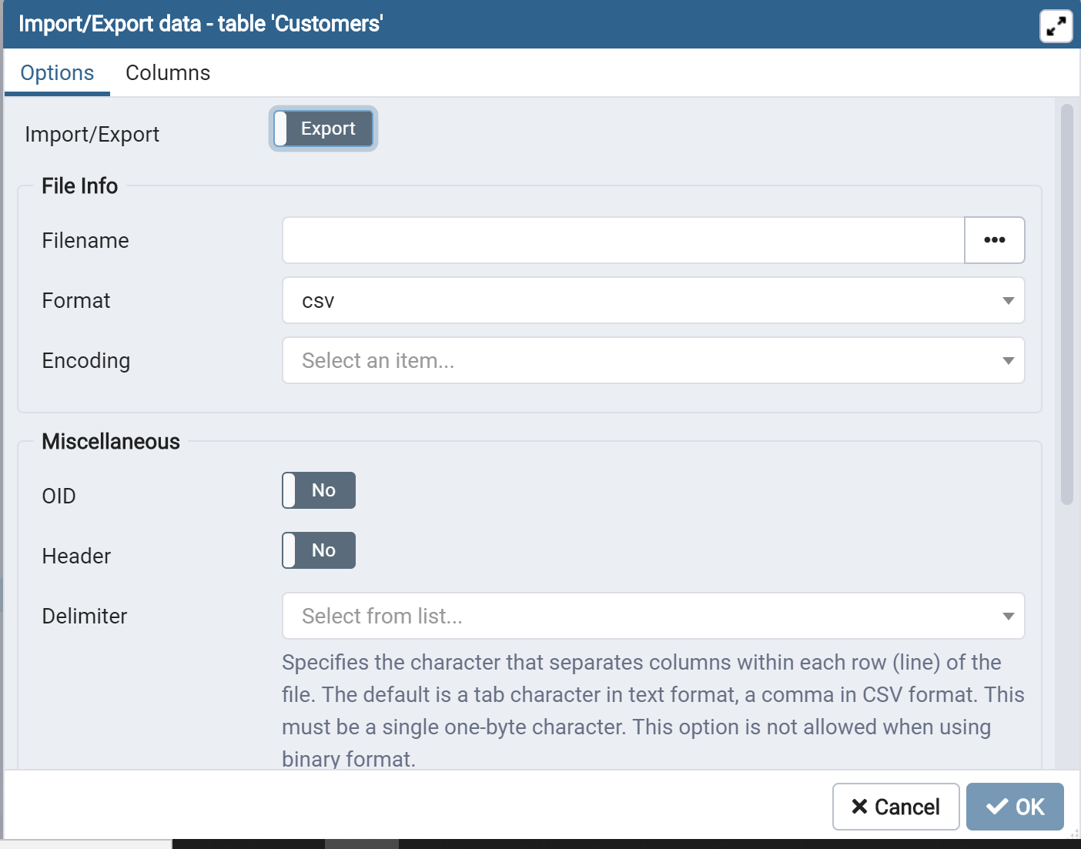
Insert Data into Tables (Records)
````
Postgres SQL
2.) Select Import
(eXcelerate)

Slide 10
Insert Data into Tables (Records)
````
Postgres SQL
2.) Choose Filename > Hit OK
(eXcelerate)

Slide 11
Insert Data into Tables (Records)
````
Postgres SQL
3.) Right click on table name > Choose View Data > All Rows. This verifies that all data has been properly uploaded.
(eXcelerate)

